Slide 1
MULTI-WAVELENGTH
ASTRONOMY
(or “Oh Say, What Can You See
by Different Kinds of Light ?”)

Slide 2
How Fast is Light?
Speed of light designated by the letter “c”
Nothing can go faster
c = 186,000 miles per second (in a vacuum)
How many miles does light travel in one year? 6 trillion (= 6 million million) miles

Slide 3
What Kinds of Light Are There?
Electromagnetic radiation includes a lot more than just the light we use to see with.
Look at the diagram on the next slide.

Slide 4
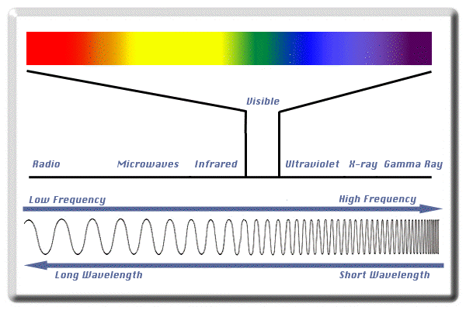
LOW ENERGY HIGH ENERGY

Slide 5
Energy, Frequency, and Wavelength – Basic Stuff
The diagram shows different kinds of Electromagnetic Radiation.
Right side of the diagram = highest energy = very high frequency = very short wavelength.
Left side of the diagram = lowest energy = very low frequency = very long wavelength.

Slide 6
Energy, Frequency, and Wavelength – Gamma Rays
Gamma Rays (right side of the diagram) have the highest energy of all – even more powerful than X-Rays.
Gamma Rays have very high frequency and very short wavelength. They will fry you fast.

Slide 7
Energy, Frequency, and Wavelength – Visible Light
Visible Light is in the middle of the Electromagnetic Spectrum, so it’s intermediate in energy. Visible Light has intermediate frequency and intermediate wavelength.
Human eyes use Visible Light to see.

Slide 8
Energy, Frequency, and Wavelength – Visible Light (cont’d)
Remember the colors of Visible Light – red, orange, yellow, green, blue, indigo, violet (ROYGBIV).
Red light = lower energy/longer wavelength.
Violet light = higher energy/shorter wavelength.

Slide 9
Energy, Frequency, and Wavelength – Infrared & Ultraviolet
“Infrared” means “below the red,” so Infrared has lower energy/longer wavelength than visible red light. Infrared = heat radiation.
“Ultraviolet” means “beyond the violet,” so Ultraviolet has higher energy/shorter wavelength than visible violet light.
BTW, bees can see in Ultraviolet – flowers look different to them than what we humans see.

Slide 10
Energy, Frequency, and Wavelength – Radio Waves
Radio Waves (left side of the diagram) have the lowest energy of all.
Radio Waves have very low frequency and very long wavelength. Everyday examples include microwaves (ovens and cell phones), FM radio, TV, and AM radio.
The Big Bang (creation of the Universe) left microwaves that are more than 13 billion years old. Who knew ?!

Slide 11
Gamma Rays
Temperature = more than 10⁸ (100 million) degrees Kelvin (K) = highest energy of all (ºKelvin = ºC + 273)
Objects that give off Gamma Rays
  Interstellar clouds where cosmic rays collide with hydrogen nuclei
  Accretion disks around black holes
  Pulsars or neutron stars

Slide 12
X-Rays
Temperature = 10⁶ to 10⁸ K (1 million to 100 million degrees)
Objects that give off X-Rays
  Regions of hot, shocked gas
  Hot intergalactic gas in clusters of galaxies
  Neutron stars
  Supernova remnants
  Stellar coronas

Slide 13
Ultraviolet
Temperature = 10⁴ to 10⁶ K (10 thousand to 1 million degrees)
Objects that give off Ultraviolet
  Supernova remnants
  Very hot stars
  Quasars

Slide 14
Visible Light
Temperature = 10³ to 10⁴ K (1 thousand to 10 thousand degrees)
Objects that give off Visible Light
  Planets
  Stars
  Galaxies
  Reflection nebulae
  Emission nebulae

Slide 15
Infrared (Heat Radiation)
Temperature = 10 to 10³ K (10 to 1 thousand degrees)
Objects that give off Infrared
  Cool stars
  Star-forming regions
  Interstellar dust warmed by starlight
  Planets
  Comets
  Asteroids

Slide 16
Radio Waves (including Microwaves)
Temperature = less than 10 K = lowest energy of all
Objects that give off Radio Waves
  Cosmic Background Radiation from The Big Bang
  Inter-stellar plasmas
  Cold interstellar medium
  Regions near neutron stars
  Regions near white dwarfs
  Supernova remnants
  Dense regions near centers of galaxies
  Cold dense regions in spiral arms of galaxies

Slide 17
Family Photo Album
Let’s take a look at some of the members of the astronomical fam seen in different kinds of light (different radiation wavelengths).
A planet – Saturn
A star – our Sun
A nebula formed by an exploding star
A couple of galaxies
The Universe (really !!)

Slide 18
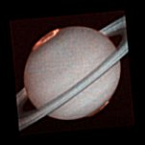
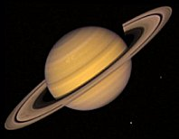
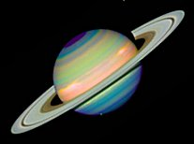
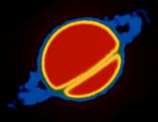
Saturn – Different Wavelengths

Slide 19
Saturn – Different Wavelengths
Ultraviolet Visible
Infrared Radio

Slide 20
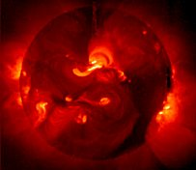
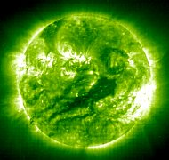
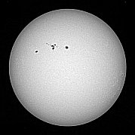
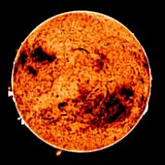
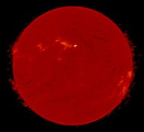
Sun – Different Wavelengths

Slide 21
Sun – Different Wavelengths
X-Ray Ultraviolet
Visible Infrared Radio

Slide 22
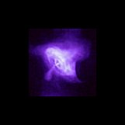
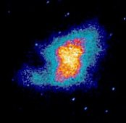
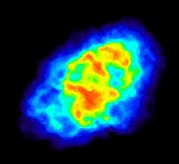
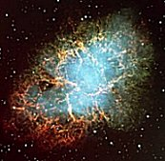
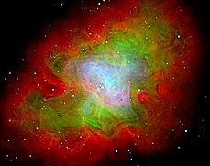
Supernova Remnant (Crab Nebula)

Slide 23
Supernova Remnant (Crab Nebula)
X-Ray Ultraviolet
Visible Radio XR+Vis+Radio

Slide 24
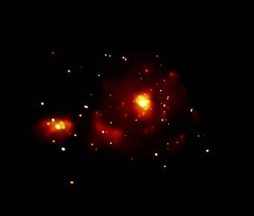
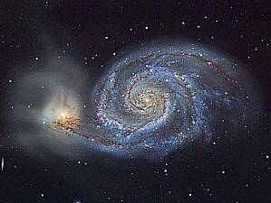
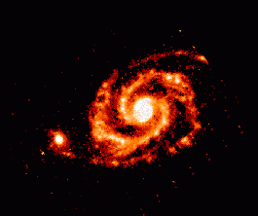
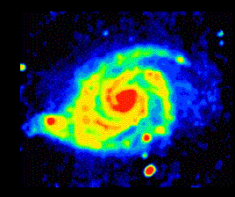
Whirlpool Galaxy M 51

Slide 25
Whirlpool Galaxy M 51
X-Ray Visible
Infrared Radio

Slide 26
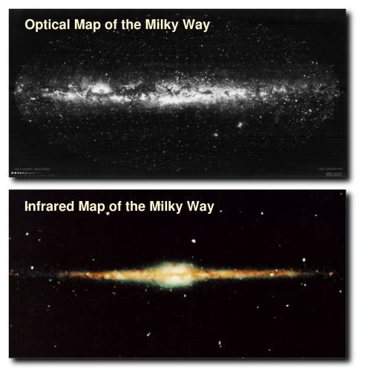
Our Galaxy – The Milky Way

Slide 27
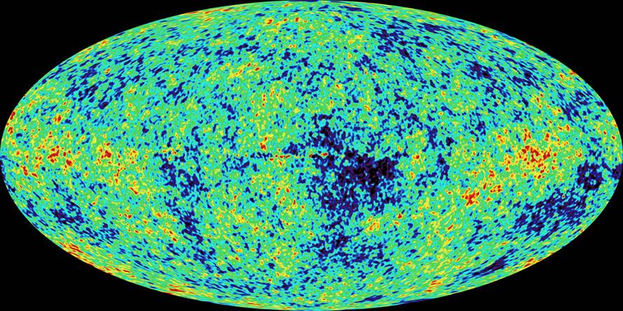
The Universe – Cosmic Microwave
Background from The Big Bang

Slide 28
Where are the Telescopes ?
For Gamma Rays, X-Rays, Ultraviolet and Infrared, the telescopes have to be above the Earth’s atmosphere. Why ?
For Visible Light and Radio Waves, the telescopes can be on the Earth’s surface or above the atmosphere. Why ?
Following are some famous telescopes.

Slide 29
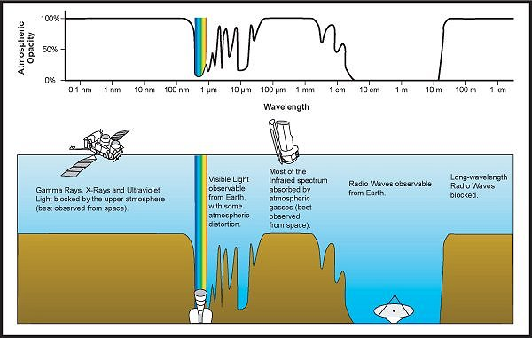
Thanks to Tim Compernolle

Slide 30
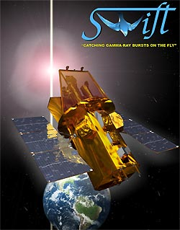
Swift Gamma Ray Telescope

Slide 31
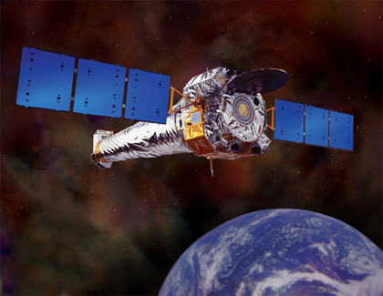
Chandra X-Ray Observatory

Slide 32
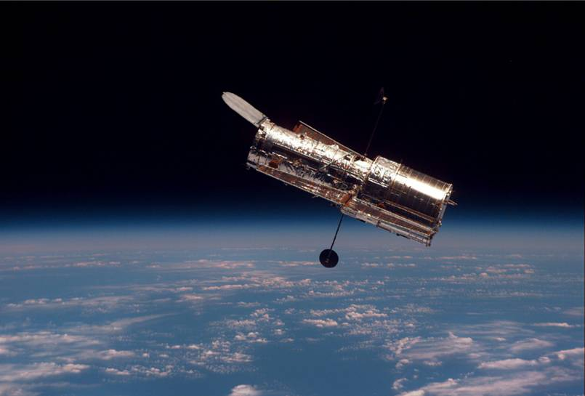
Hubble Space Telescope
(Ultraviolet, Visible, Infrared)

Slide 33
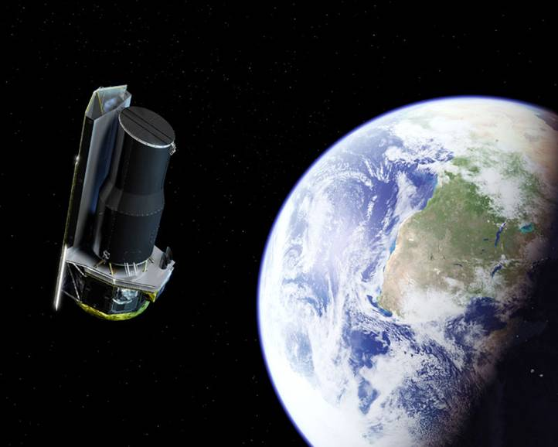
Spitzer Space Telescope
(Infrared)

Slide 34
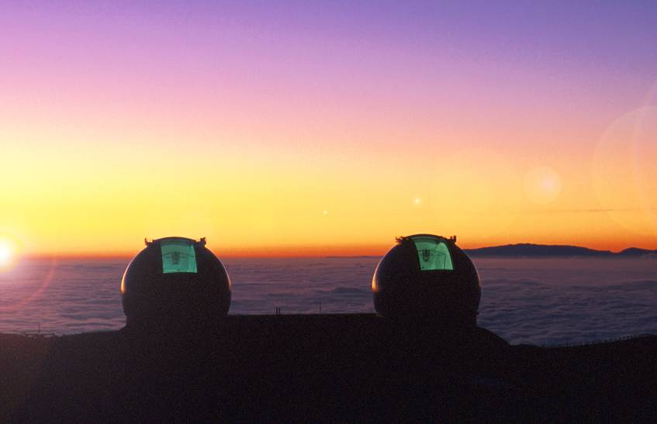
Keck Telescope – Hawaii
(Visible)

Slide 35
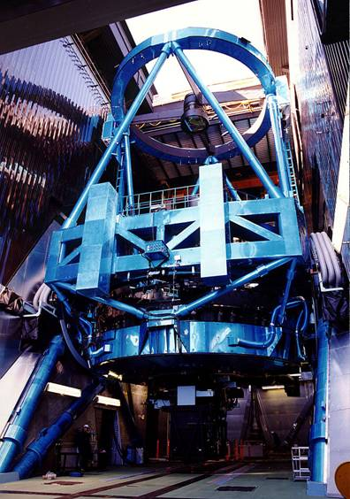
Keck Telescope – Hawaii
(Visible)

Slide 36
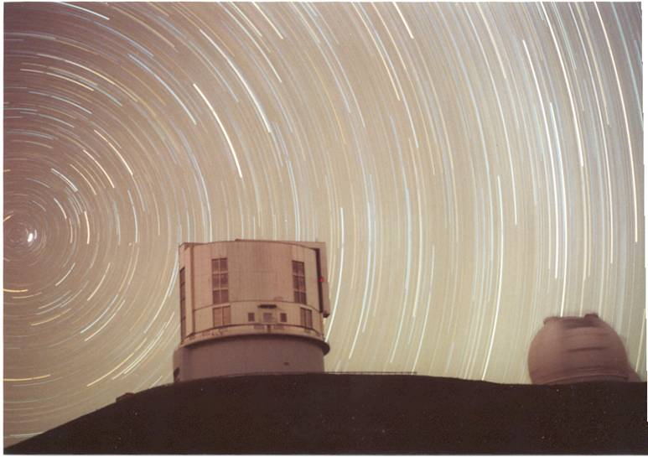
Keck Telescope – Hawaii
(Visible)

Slide 37
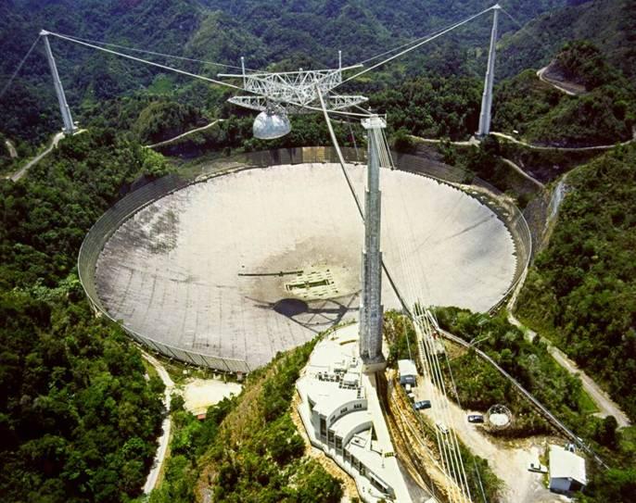
Arecibo Radio Telescope –
Puerto Rico

Slide 38
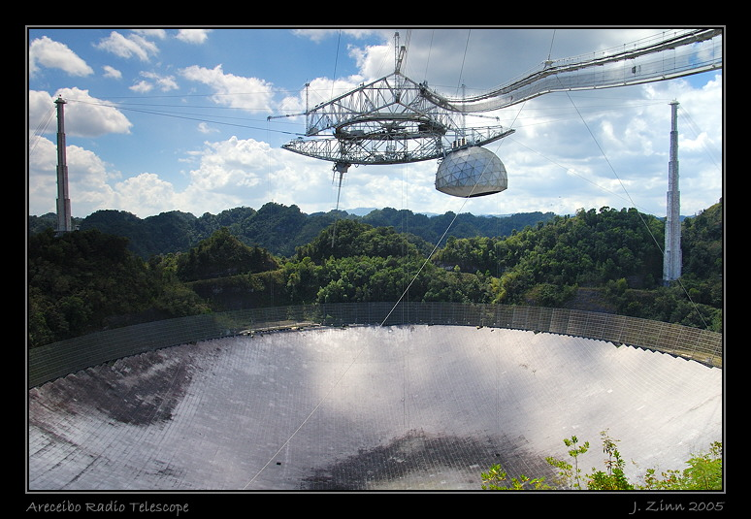
Arecibo Radio Telescope –
Puerto Rico

Slide 39
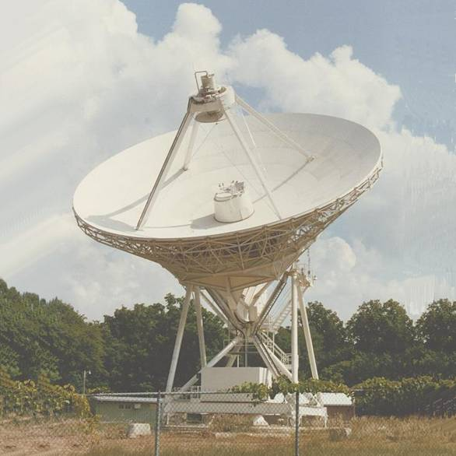
Radio Telescope

Slide 40
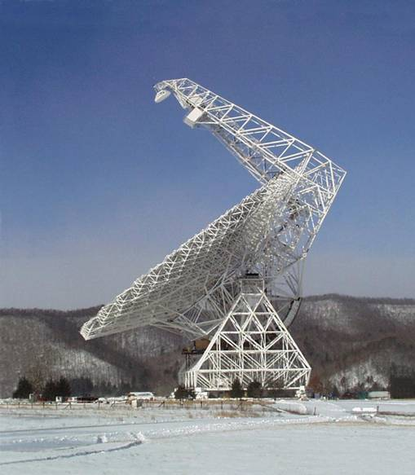
Radio Telescope

Slide 41
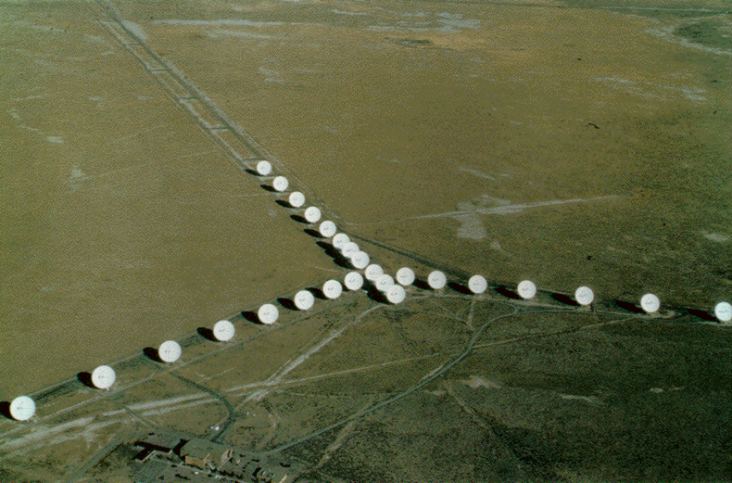
Radio Telescope – Very Long
Baseline Array

Slide 42
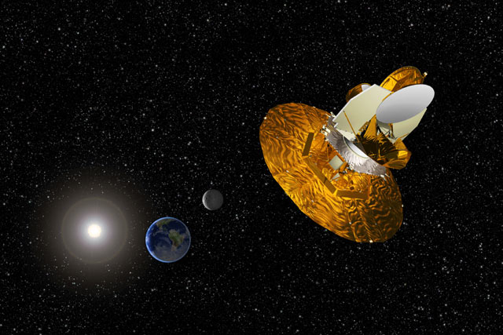
Wilkinson Microwave
Anisotropy Probe (WMAP)

Slide 43
Light is Weird – Part 1 – Photons
Light sometimes behaves like a wave, like we have been talking about.
But light also can behave like a particle (called a photon).
Einstein proposed that light travels as waves with the energy enclosed in photons.
Shorter wavelength = higher energy photon.
Longer wavelength = lower energy photon.
So what kind of light has the highest energy photons? Look at the Electromagnetic Radiation diagram.
What kind of light has the lowest energy photons? Look at the diagram.

Slide 44
LOW ENERGY HIGH ENERGY

Slide 45
Light is Weird – Part 2 –
Doppler Shift
Light wavelength is changed by motion of the light source – just like sound waves are.
This means light changes color according to how the light source is moving.
Light source (like a star) moves away from you = light looks more red to you = Doppler Redshift.
Light source (like a star) moves toward you = light looks more blue to you = Doppler Blueshift.
Look at the following diagrams.

Slide 46
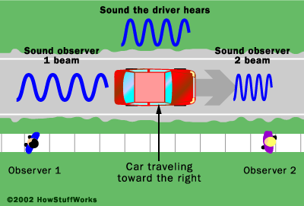
Doppler Shift for Sound

Slide 47
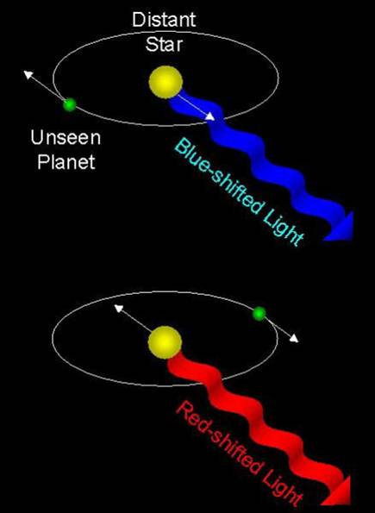
Doppler Shift for Light – Moving Star

Slide 48
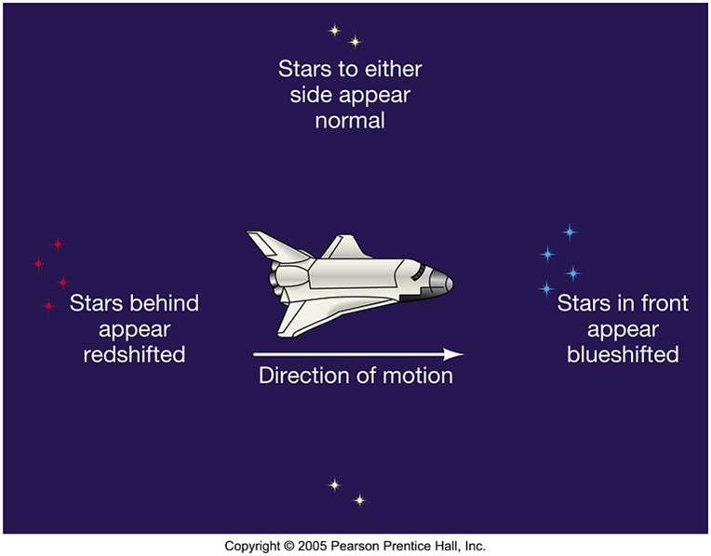
More Doppler – What if YOU are Moving?

Slide 49
Light and Telescopes – What Do You Think? (Ch. 3, p. 62)
What is light?
Which type of electromagnetic radiation is most dangerous to life?
What is the main purpose of a telescope?
Why do stars twinkle?
What types of electromagnetic radiation can telescopes currently detect?

